Slide 1
Introduction of Math of MBD
Part 3: Special Features in MBD
Flexible Bodies & Contact
Graham Sanborn
FunctionBay, Inc. R&D Group.
2022/04/08
Copyright © 2022 FunctionBay, Inc. All rights reserved.

Slide 2
Overview
Goal
Introduce the mathematics of Multibody Dynamics
3 Parts:
MBD Equations of Motion
Solving the Equation of Motion
Special Features
Flexible bodies
Contact

Slide 3
Presentation Parts
MBD requires 2 parts:
Equations of motion
f = ma
The solution to the equations of motion
time stepping
MBD’s capabilities can be significantly extended with additional features.
Flexible bodies
Contact

Slide 4
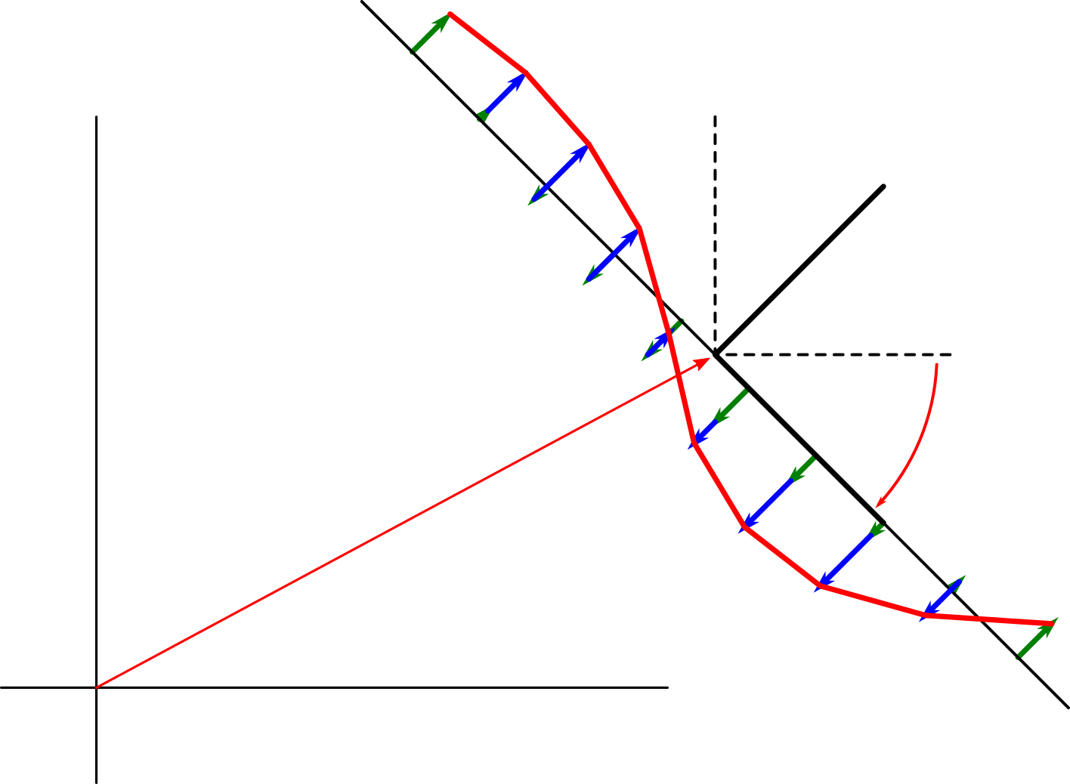
Part 3:
Flexible Bodies and Contact

Slide 5
Flexible Bodies in RecurDyn
Flexible bodies
There are 2 formulations for flexible bodies in RecurDyn
FFlex (Full Flex)
RFlex (Reduced Flex)
Both are general purpose bodies.
Can be used in any model for any body.
Can be connected with constraints or elastic elements to any other body.
Can make contact with any other body.

Slide 6
FFlex (Full Flex)
FFlex (Full Flex)
“Full” means “Full nodal degrees of freedom”.
Every node is free to move.
It is a general purpose flexible body.
Useful for almost every kind of model.
Complex contact
Stress concentrations
Nonlinear deformation (lots of deformation)
Nonlinear materials (rubber, plastic)
It is general finite elements
Modified for MBD
All elements can rotate.

Slide 7
RFlex (Reduced Flex)
RFlex (Reduced Flex)
A flexible body with a very small number of DOFs.
Uses modal reduction.
Deformation in vibration mode shapes only
Simulates VERY quickly.
Useful for simple flexible problems
Small deformation only
Only linear materials
Deformation similar to vibration mode shapes

Slide 8
FFlex and RFlex Elements
Both FFlex and RFlex are based on the finite element method (FEM).
FFlex extends general finite elements (FE) for large rotation.
RFlex uses FE modal reduction with a rotating reference frame.
So it is important to understand FEM first.

Slide 9

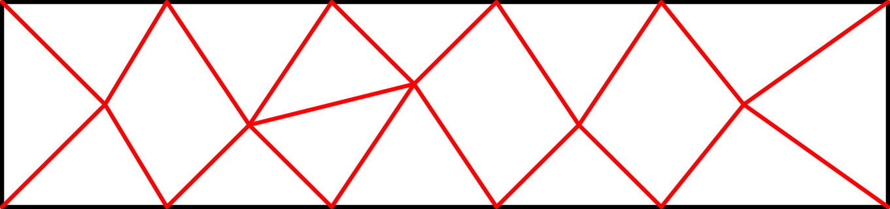
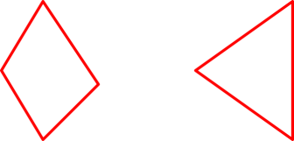
The Finite Element Method (FEM)
A body is divided into small volumes.
Each volume is an element.
Elements have simple shapes.
Original body
Body divided into elements
Simple-shaped elements

Slide 10
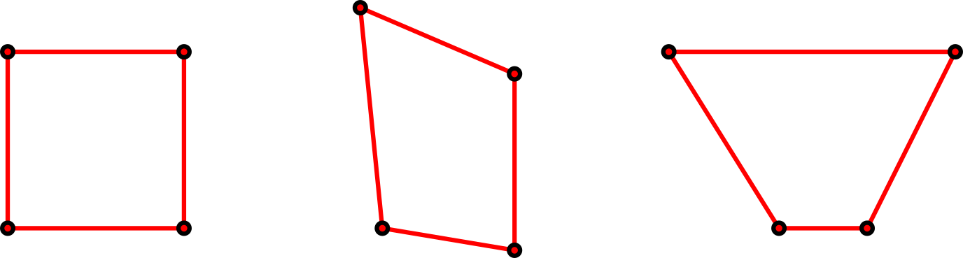
The Finite Element Method (FEM)
The elements can change shape.
The shapes are controlled by the “nodes”.
Nodes
Moving the nodes changes the shape of the element.

Slide 11
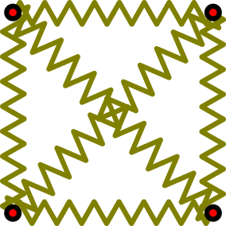
The Finite Element Method (FEM)
Each element behaves like an elastic spring.
The spring forces are applied to the nodes.
Elements make forces to pull the nodes back to their original position.

Slide 12
The Finite Element Method
The finite element method has 2 main parts
Nodes: Mass
Nodal masses become the mass matrix.
Element: Force
Element forces become the force vector.
Nodal masses
Element forces (and gravity)

Slide 13
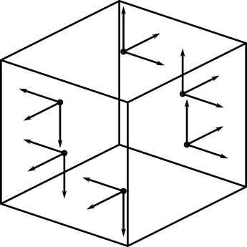
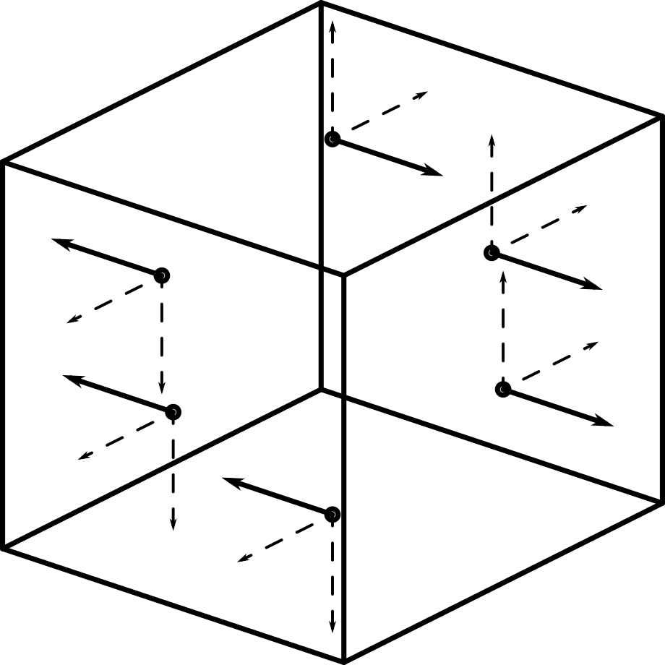
Common Finite Element Formulation Techniques
The Basis of the finite element method:
Stresses acting on the face of a tiny cube.
An infinitesimal cube has stresses on every face.
Infinitesimal x forces from stress acting on faces of an infinitesimal cube
Net infinitesimal x, y, and z forces from stress acting on an infinitesimal cube
Notes:
σ

Slide 14
Common Finite Element Formulation Techniques
The finite element formulation can be derived through many methods.
One common method to derive FEM is virtual work:
This integral is:
VirtualDisplacement * (f/vol = m/vol * a)
density * acceleration
Virtual displacement
Gravity force density
Gradient (change w.r.t. position) of stress = pressure force/vol

Slide 15
Common Finite Element Formulation Techniques
Derivation requires math
Lots of math.
There are no simple books.
Maybe recommend:
Computational Continuum Mechanics (Shabana, 2008)
A simpler derivation is shown in this document.
Possible to get basic understanding of FEM without a rigorous derivation.

Slide 16
Finite Element Mass
Various methods to formulate mass matrix.
Simplest is lumped mass
Each node gets a mass like a rigid body
Fast and easy to compute.
Reasonably accurate.
Another method: “Consistent mass”
Consult a text for information about this formulation.
System mass matrix
Nodal mass matrix
n_{n} = Number of nodes
n_{nc} = Number of nodal coordinates

Slide 17
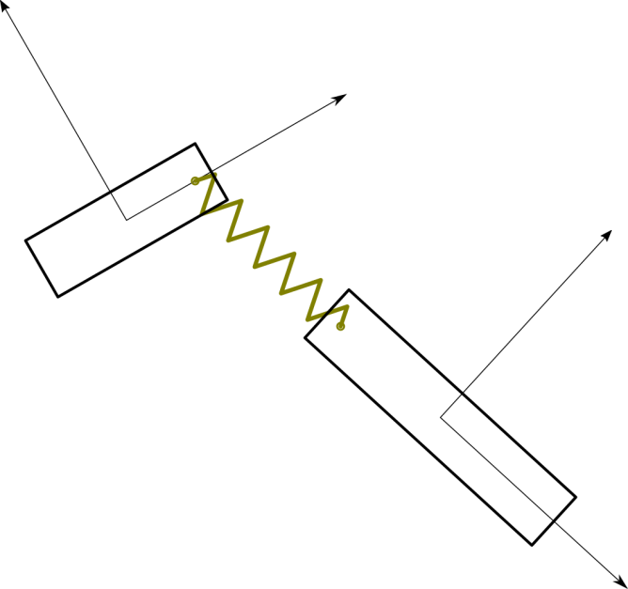
MBD Spring Force Formulation
A finite element’s force is like a spring’s force.
First, recall the MBD spring force formulation from Part 1:
Element’s internal force
Gap function
Matrix of stiffness coefficients
Multiply by derivative of gap function to transform element force into body forces

Slide 18
Finite Element Force Formulation
A finite element’s force is like a spring’s force.
The FE elastic force formulation is very similar
But it uses an integration over the volume of the element.
(for a linear elastic material)
Element’s internal stress
strain (change of shape) function
Matrix of stiffness coefficients
Multiply by derivative of strain to transform stress into nodal forces

Slide 19
Spring and Finite Element Force Similarities
MBD and FE forces
Many of the force formulations are very similar in dynamics.
Spring elastic forces
Constraint forces
Finite element elastic forces
Spring force
Constraint force
Finite element force

Slide 20
Elastic Energy and Force
The forces are related to energy.
Spring energy: Spring force:
FE energy: FE force:
(for linear elastic materials)

Slide 21
Energy vs. Energy Density
One difference between spring energy and finite element energy
The spring formulation uses energy.
The FE formulation uses energy density.
Spring
Finite Element
Energy
Energy density

Slide 22
Relation Between Energy and Force
There is a relationship between energy and force
The force on a coordinate is the derivative of energy w.r.t. that coordinate.
This can be seen in the definition of work:
Work is the change in energy.
Work = force x displacement.
Therefore, if there is an expression for the strain energy, it can be used to find the nodal forces directly.

Slide 23
Linear Stress-Strain Relationship
The finite element elastic force for a linear stress-strain relationship is
where Dε is equal to the stress at a point in the element.

Slide 24
Linear Stress-Strain Relationship
The stress and strain are expressed in vector form in this equation.
Stress vector
Strain vector
Elastic moduli matrix
(Example: a linear isotropic material)
μ and λ are lame’s parameters.

Slide 25
Vector Notation
It is possible to derive the finite element force using tensor notation rather than vector notation for the stress and strain.
Over-bar “ ‾‾ ” means “tensor form”.
ε̅ is a 2nd order tensor (3x3)
D̅ is a 4th order tensor (3x3x3x3)
However, in this document, vector notation is used in most cases.

Slide 26
Strain as Function of Nodal Coordinates
To evaluate the element force, strain is needed.
Strain is a function of nodal coordinates.
The definition of strain is found in continuum mechanics.

Slide 27
Strain as Function of Nodal Coordinates
What is ε?
Strain is function of the derivative of the displacement field w.r.t. position in the field.
(ε̅_{l} is the small strain formulation)

Slide 28
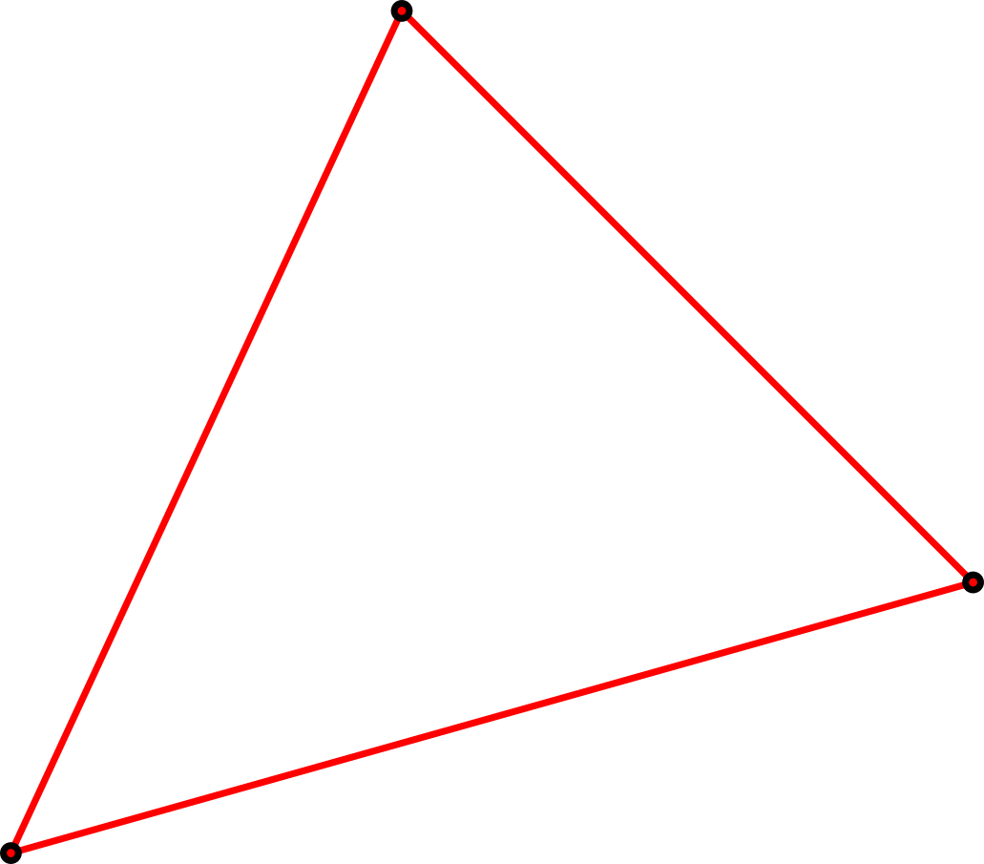
The Displacement Field
ε is found from an element’s displacement field.
An element’s displacement field starts with its nodal coordinates.
An element, defined by those nodal coordinates
The element vector of nodal coordinates
q¹
q³
q²

Slide 29
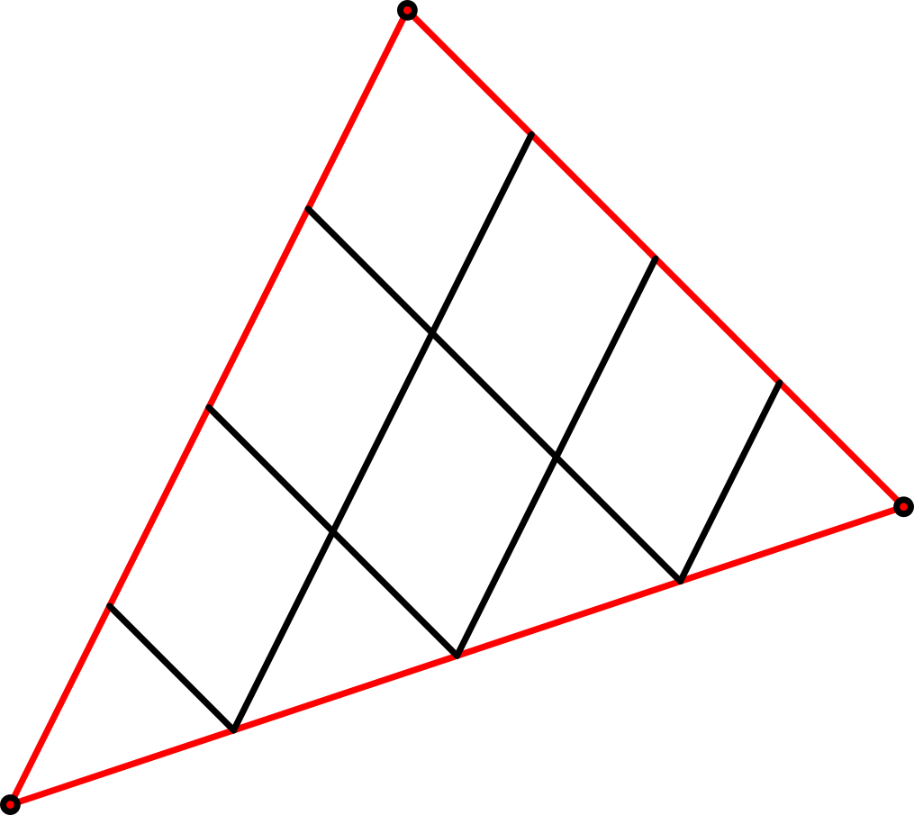
Element Parameterization
Every element’s volume is parameterized.
A material point is uniquely identified by a unique set of parameters (ξ₁, ξ₂, ξ₃).
3D elements usually have 3 parameters.
q¹
ξ₁ = 0
ξ₂ = 0
ξ₂ = 1/4
ξ₁ = 1/4
ξ₂ = 1/2
ξ₂ = 3/4
ξ₁ = 1/2
ξ₂ = 1
ξ₁ = 3/4
q³
A 2D triangle element example.
Only has parameters (ξ₁, ξ₂).
ξ₁ = 1
q²

Slide 30
Position of a Point in an Element
Location of a point r defined by parameters ξ = (ξ₁, ξ₂, ξ₃) is usually a weighted average of the nodal coordinates q¹, …, q^{n}.
The weighting functions are called “shape functions”.
Shape functions: n^{i}
Weighting functions (shape functions)
Weighted average of nodal coordinates

Slide 31
Shape Functions
Shape functions n^{i} are a function of only the parameters
ξ = (ξ₁, ξ₂, ξ₃).
For example, the shape functions for a 2D triangle are:
Note that
ξ₁ = 0
q¹
ξ₂ = 0
ξ₂ = 1/4
ξ₁ = 1/4
ξ₂ = 1/2
ξ₂ = 3/4
ξ₁ = 1/2
ξ₂ = 1
ξ₁ = 3/4
q³
ξ₁ = 1
q²

Slide 32

Example Points in an Element
For example:
The midpoint of a 2D triangle element.
q¹
ξ₂ = 1/3
ξ₁ = 1/3
r(1/3, 1/3)
q³
q²

Slide 33

Example Points in an Element
For example:
A point on the edge between q₂ and q₃, 25% of the distance from q₂ to q₃.
q¹
ξ₂ = 1/4
q³
ξ₁ = 3/4
r(3/4, 1/4)
q²

Slide 34
The Matrix of Shape Functions
The shape functions n^{i} are usually written as a matrix N.
Then the position of a point can be written

Slide 35
Calculating Deformation
Strain is a measure of deformation.
To calculate deformation, an undeformed version of the element is required.
Every element has 2 important configurations:
The current configuration
An undeformed configuration.
Nodal coordinates of the undeformed configuration.

Slide 36
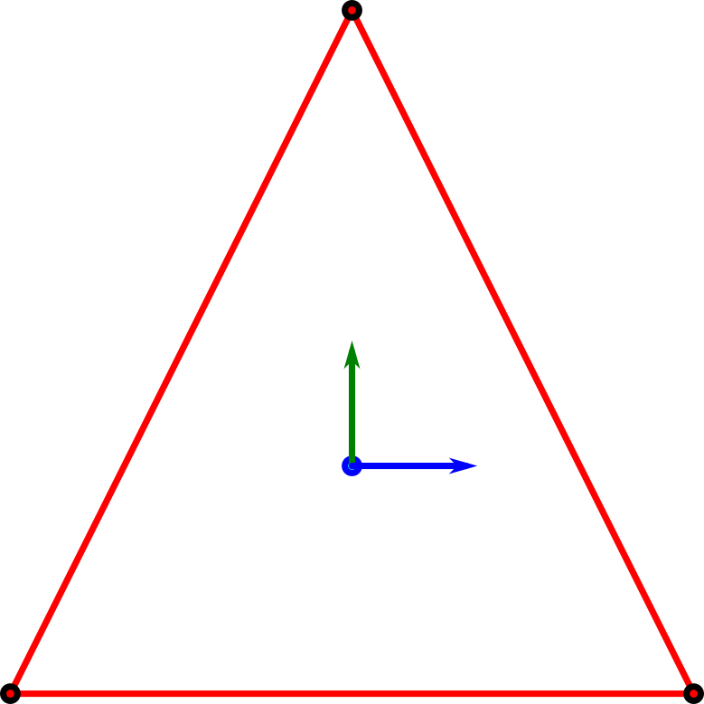
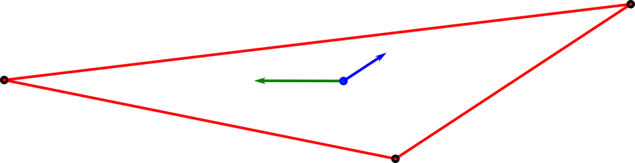
Calculating Deformation
The deformation gradient F = dr/dx.
Draw axis-aligned vectors on the undeformed element.
The columns of F are the current direction of those vectors.
2D example of the deformation gradient F
Undeformed configuration
Current configuration
Current v_{x} = [0.83 0.56]^{T}
vʹ_{y} = [0 1]^{T} = undeformed y-axis
Current v_{y} = [1.8 0]^{T}
vʹ_{x} = [1 0]^{T} = undeformed x-axis
Axis-aligned lines drawn on the undeformed element.

Slide 37
The Mathematics of Deformation
The deformation gradient is fundamental measure of deformation.
Used to formulate strain.
Can be easily computed.

Slide 38
The Mathematics of Deformation
r and x are both functions of ξ.
So we can calculate the derivatives of r and x w.r.t. ξ.

Slide 39
The Mathematics of Deformation
For example, N for a 2D triangular element is
So its derivatives w.r.t. ξ₁ and ξ₂ are
Now r_{,ξ} and x_{,ξ} can be computed.

Slide 40
The Mathematics of Deformation
Compute dr/dx using the chain rule of differentiation.
dξ/dx is the inverse of dx/dξ.
So:

Slide 41
Strain
Nonlinear strain is the change in length of an infinitesimal vector on the undeformed body.
This strain is the “Green-Lagrange strain”.
vʹ_{y} = [0 1]^{T} = undeformed y-axis
vʹ_{x} = [1 0]^{T} = undeformed x-axis
Current v_{x} = [0.83 0.56]^{T}
Current v_{y} = [1.8 0]^{T}

Slide 42
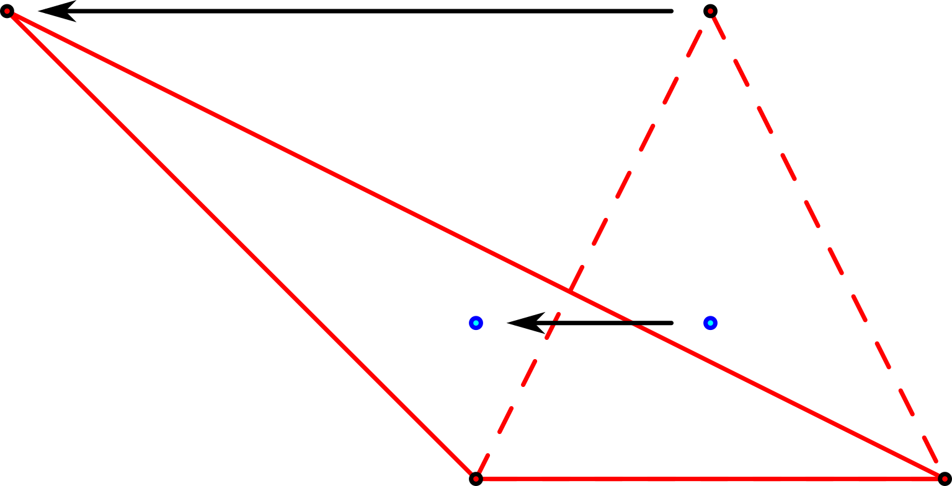
Displacement Gradient
Displacement u
Change in position from undeformed position x to current position r.
u(0, 0)
x(0, 0) = q₀¹
r(0, 0) = q¹
u(1/3, 1/3)
r(1/3, 1/3)
x(1/3, 1/3)
q² = q₀²
q³ = q₀³

Slide 43
Displacement Gradient
The displacement gradient H is related to the deformation gradient F.

Slide 44
Green-Lagrange Strain using H
Strain using the displacement gradient
Noting that the conversion from F to H is
Then the Green-Lagrange strain tensor can be written

Slide 45
Small Strain
If only considering small displacements, then the nonlinear term H^{T}H is composed of small values squared.
So the values are so small that they can be ignored.
This produces linear strain:
0

Slide 46
Small Strain
Small strain can be written in vector form as well.

Slide 47
Splitting Small Strain
Small strain can be written in the form
where B is a function of only parameters ξ.
But to achieve this, derivatives of N w.r.t. x are needed.
If we have that, the elements of H can be written:

Slide 48
Splitting Small Strain
ξ₁ = 0
q¹
ξ₂ = 0
ξ₂ = 1/4
N is a function of ξ, not x.
But we want this.
We can use this to convert between them
ξ₁ = 1/4
ξ₂ = 1/2
ξ₂ = 3/4
ξ₁ = 1/2
ξ₂ = 1
ξ₁ = 3/4
q³
ξ₁ = 1
q²

Slide 49
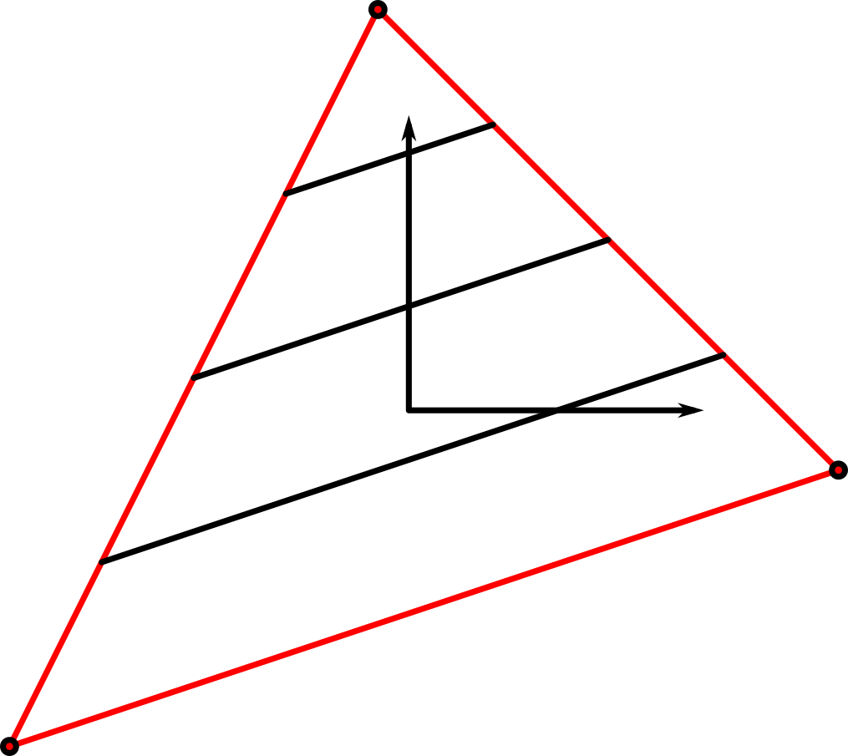
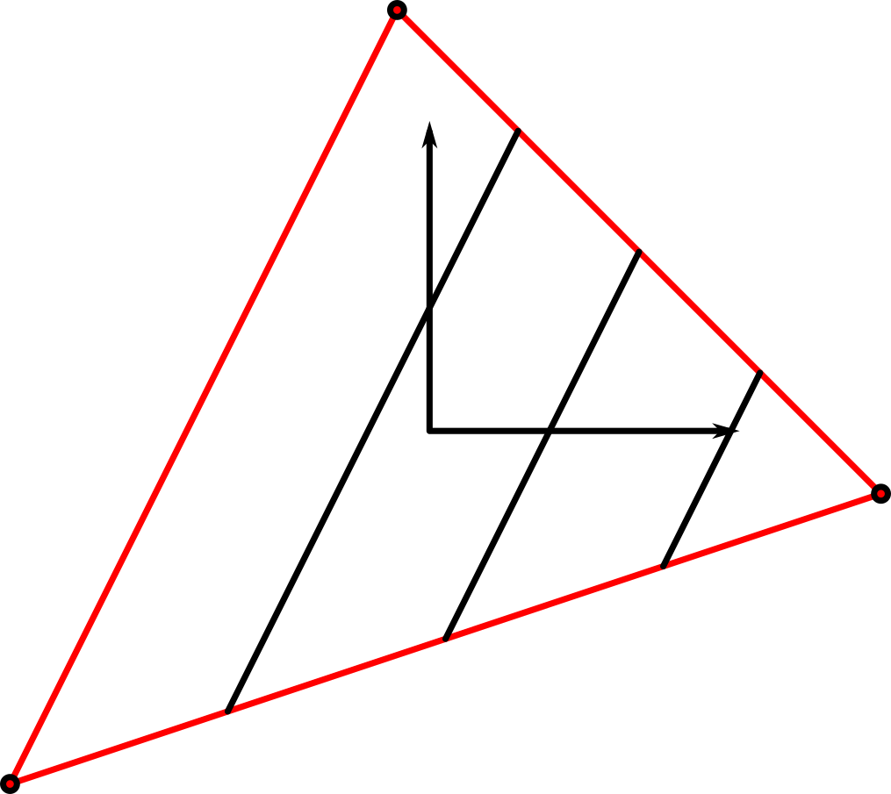
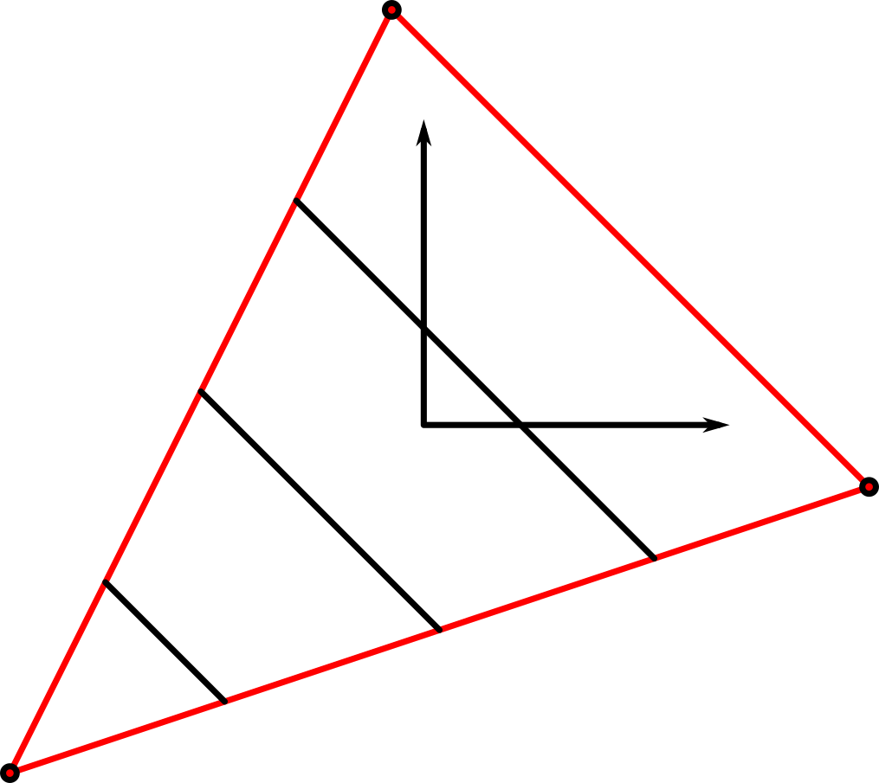
Splitting Small Strain
Derivatives N_{,x}:
Shape functions in the undeformed configuration
n₁
n₂
n₃
q₀¹
q₀¹
q₀¹
q₀³
q₀³
q₀³
q₀²
q₀²
q₀²

Slide 50
Splitting Small Strain
Then use the chain rule of differentiation:

Slide 51
Splitting Small Strain
The displacement gradient can now be written
If the matrix N is written as rows
then:

Slide 52
Splitting Small Strain
Then the vector version of small strain can be written:

Slide 53
Splitting Small Strain
Finally
where

Slide 54
Derivative of Small Strain
Note that derivatives w.r.t. d (displacement) are equal to derivatives w.r.t. q (nodal coordinates).
Because
then
As a result,

Slide 55
Small Strain Finite Element Force
Small strain element force
B is constant. It doesn’t change with time. Therefore, the integral can be evaluated before the simulation.
Constant w.r.t. time.

Slide 56
Constant Stiffness Matrix
Evaluating the integral produces K^{e}, the element’s stiffness matrix:
Then the element force is

Slide 57
Small Strain Finite Element Force
Only small strain elements with linear materials have been presented in the previous slides.
Accurate for small deformation.
Inaccurate if the element rotates relative to its reference frame.
The formulation presented is a very simple, very common formulation.
Called a “displacement-based” formulation.
“Displacement-based” means uses continuum mechanics without modification.
Many modified formulations exist that improve the element accuracy.
RecurDyn also contains large strain elements and nonlinear materials.

Slide 58
Adapting These Elements for MBD
Bodies in MBD formulations can translate and rotate freely.
Flexible bodies should be able to translate and rotate, too.
The common small-strain FE formulation is not capable of simulating element rotation.
To enable rotation, the formulation must be modified.
The small-strain formulation is usually modified to allow the reference frame to rotate.
FFlex and RFlex both use translating, rotating reference frames to enable small-strain elements to rotate.

Slide 59
Adapting These Elements for FFlex and RFlex
FFlex and RFlex both use translating, rotating reference frames.
FFlex:
Every element has its own reference frame that moves and rotates with the element.
RFlex
A single translating, rotating reference frame is used for all elements in the body.
Because all elements have the same reference frame, vibration modes can be used to reduce the number of deformation degrees of freedom.

Slide 60
Full Flex (FFlex)
FFlex is a general-purpose flexible body formulation.
The nodal coordinates of every element are the DOFs of the body.
(Unless the nodes are specifically constrained or frozen “boundary condition” elements)
Every element has its own reference frame to allow it to rotate and translate freely.
FFlex contains both small strain and large strain elements.
Only small-strain elements will be discussed here.

Slide 61
Co-Rotational Formulation
FFlex uses a formulation called a “co-rotational formulation”.
Every element has its own reference frame.
An FFlex element’s reference frame is found from its nodal coordinates.
This allows small-strain, constant stiffness matrices to rotate with the element.
The calculation of the reference frame is very inexpensive, so this has little affect on computational speed.

Slide 62
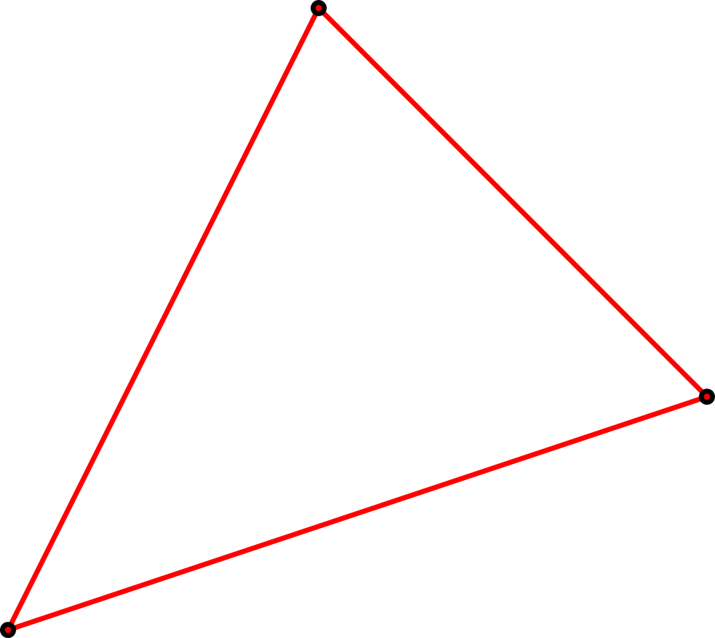
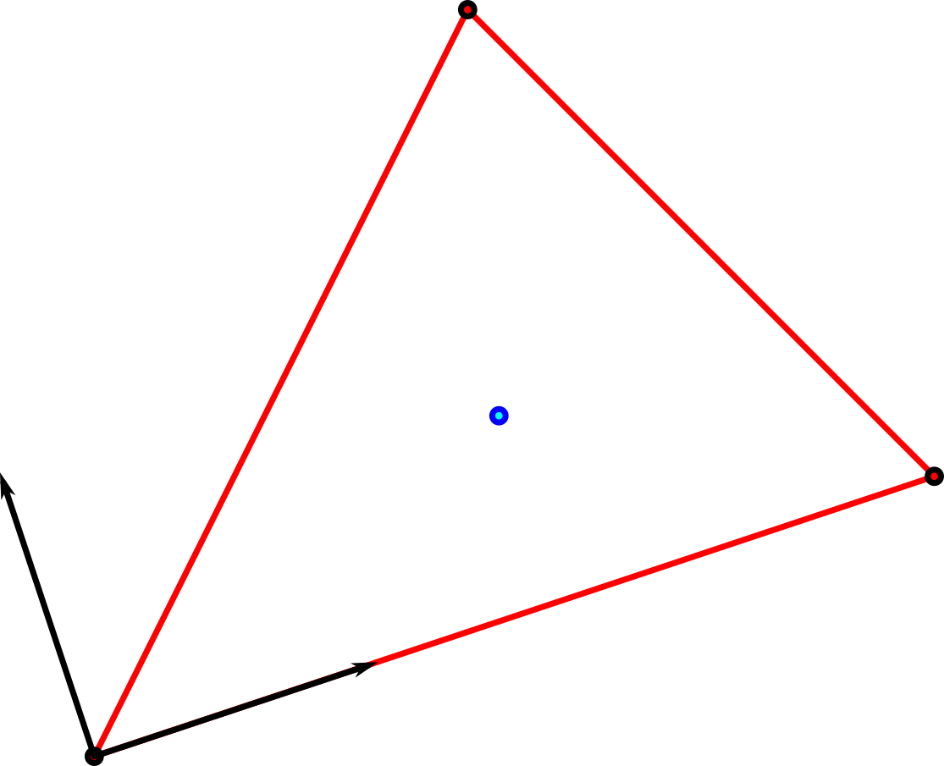
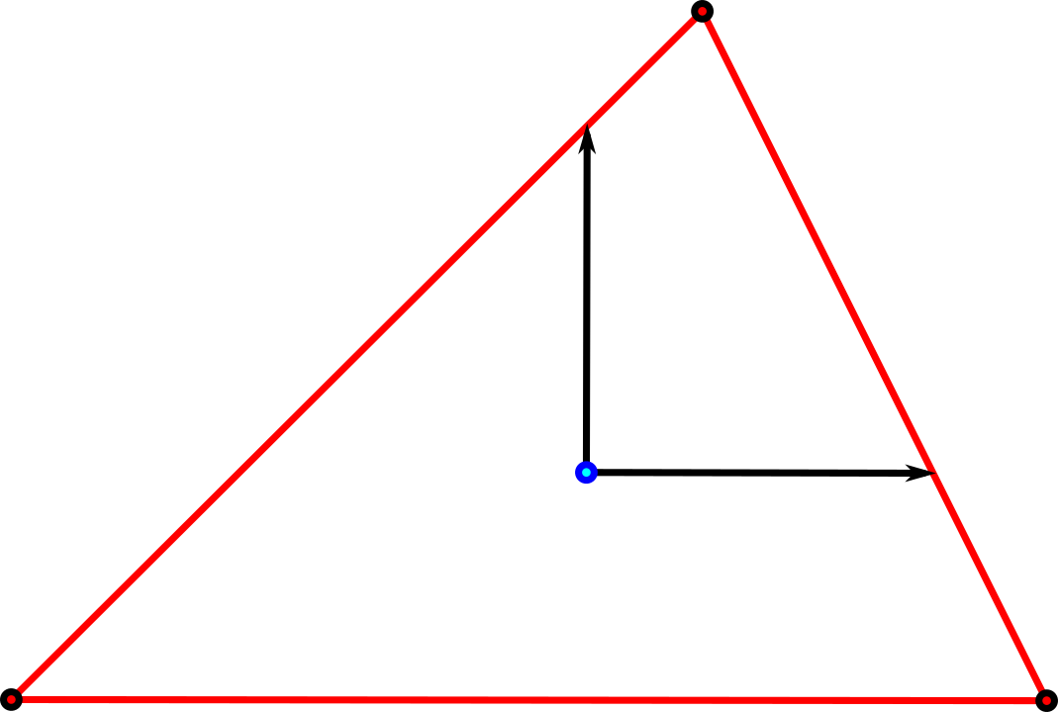
Co-Rotational Reference Frame
Reference frame example:
Identify element ref frame
Transform nodes into elem ref frame
Nodes at time t
q¹
q¹
qʹ₁e
q³
q³
qʹ₂e
qʹ₃e
q²
q²

Slide 63
Co-Rotational
To use a co-rotational frame
First, calculate the reference frame from the nodes.
q¹
A^{e}
r^{e}
q³
q²

Slide 64
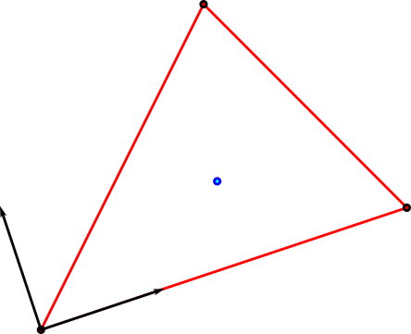
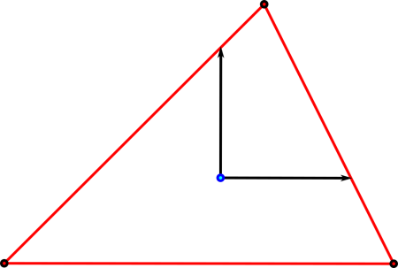
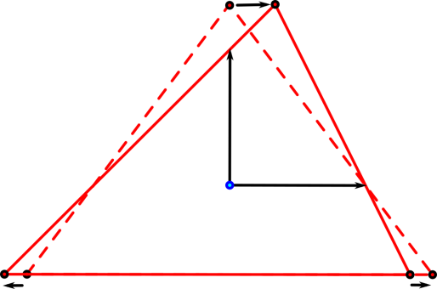
Co-Rotational
To use a co-rotational frame
Next, transform the nodes into element local coordinates
Calculate displacements
q¹
qʹ₁e
qʹ₁e
r^{e}
q³
A^{e}
qʹ₂e
qʹ₃e
q²
dʹ₁e
qʹ₂e
qʹ₃e
dʹ₂e
dʹ₃e

Slide 65
Co-Rotational
To use a co-rotational frame
Force is computed relative to the element reference frame
And it is transformed back to the global coordinates to be added to the system nodal forces.

Slide 66
Co-Rotational Stress and Strain Recovery
Stress and strain recovery
Similarly, when computing stresses and strains for user output
The stresses and strains are calculated in the element reference frame
Then they are transformed back into global coordinates.

Slide 67
Reduced Flex
Reduced Flex (RFlex) has 2 main components:
A single reference frame for all elements in a body that translates and rotates freely.
Modal reduction
Deformation is represented using vibration mode shapes.

Slide 68
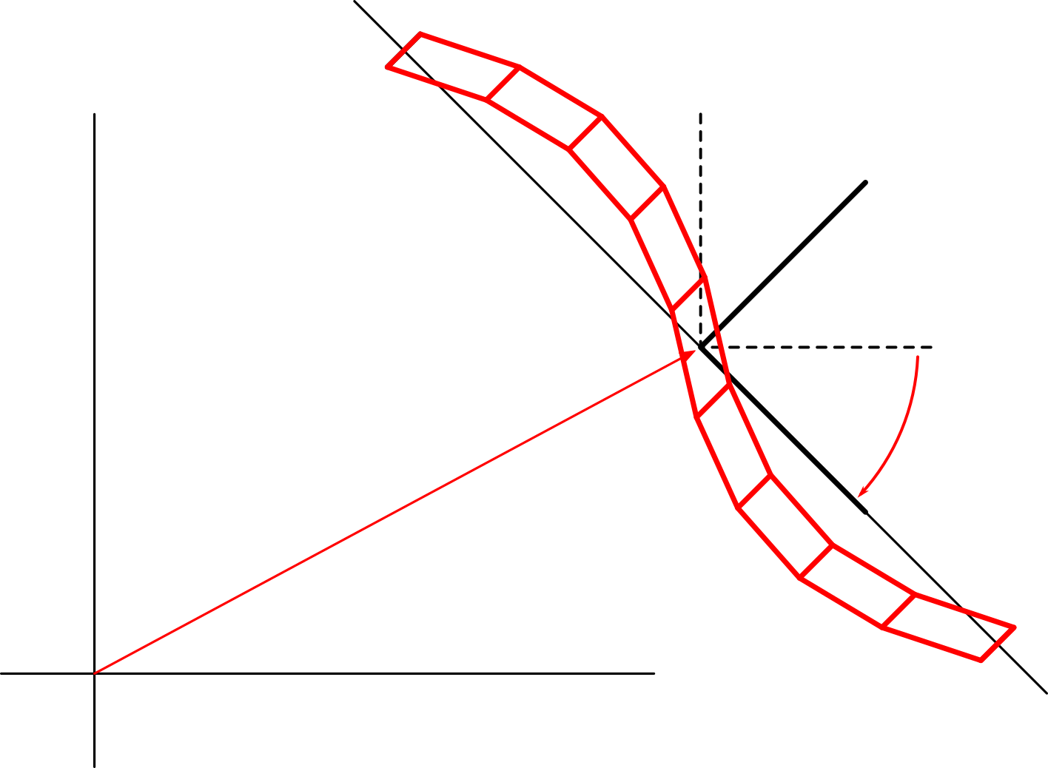
RFlex Reference Frame
The body reference frame has 6 DOFs, like a rigid body.
In 3D:
3 translational DOFs
3 rotational DOFs
All deformation is computed from the reference frame.
b^{i}
θ^{i}
x^{i}

Slide 69
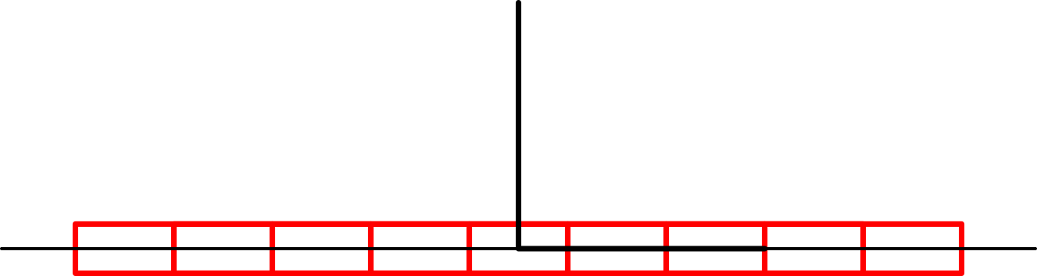
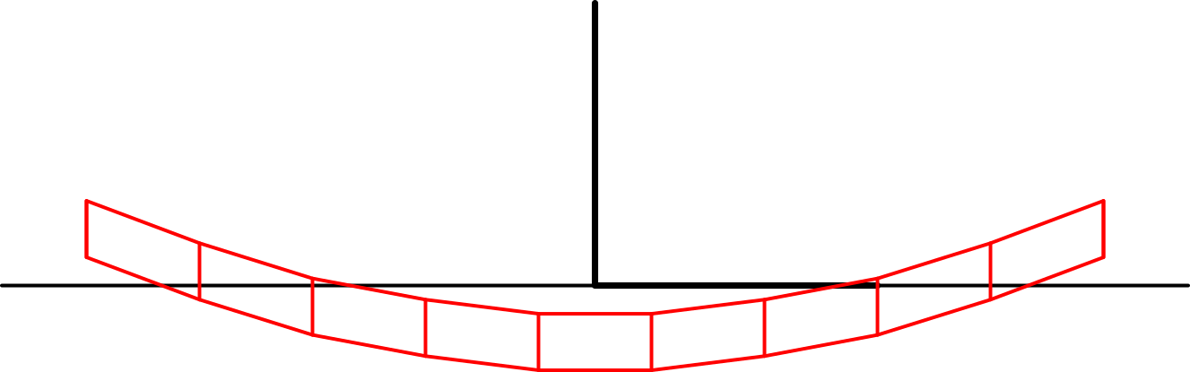
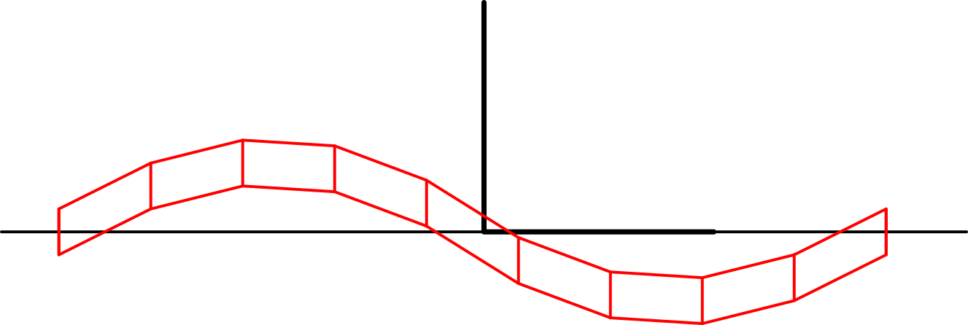
RFlex Deformation Representation
RFlex deformation is represented using vibration mode shapes.
These are the shapes that the body naturally vibrates in.
FE Body
1st vibration mode shape
2nd vibration mode shape

Slide 70
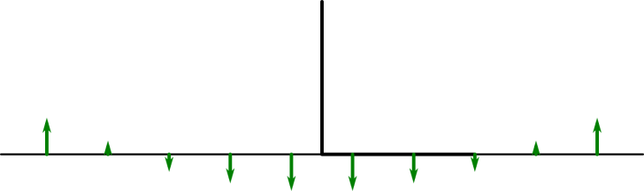
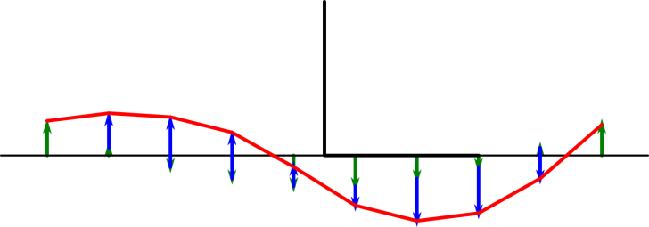
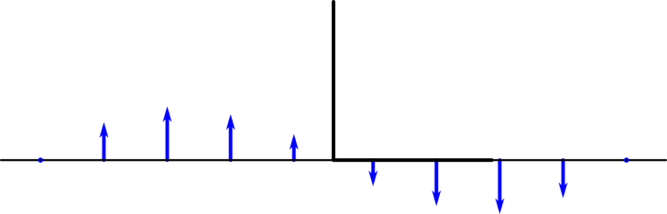
RFlex Deformation Representation
To use RFlex, the body’s mode shapes must be computed.
Computed using eigenvalue analysis.
The user chooses how many mode shapes to use.
Deformation is a sum of these shapes.
More shapes = more accurate deformation.
Fewer shapes = faster computation.

Slide 71
FE Body Matrices
To understand modal reduction, first it is necessary to introduce the FE system matrices.
A finite element body is composed of multiple elements and nodes.
Each node has a vector of nodal coordinates q_{i}^{n}.
Nodal coordinates are usually
the position of the node
(sometimes) the rotational orientation of the node.

Slide 72
FE Body Matrices
Flexible system vector of nodal coordinates q^{f}:
There will be a system vector that contains all of the nodal coordinate vectors for every node in the system.

Slide 73
FE Body Matrices
Flexible system mass matrix M ^{f}:
The flexible system has a single system mass matrix that contains all of the masses of all nodes.
RecurDyn uses “lumped masses”, in which each node has a mass similar to a rigid body.
Every node’s mass is a sum of the mass contributed to it by every element it is attached to.
System mass matrix
Nodal mass matrix
n_{n} x n_{n} (number of nodes) matrix of sub-matrices
Lumped mass matrix, so off-diagonal sub-matrices are 0.
n_{nc} x n_{nc} (number of nodal coordinates) matrix
Off diagonal terms can be non-zero.

Slide 74
FE Body Stiffness Matrix
The flexible system stiffness matrix
For small strain elements that:
Have constant stiffness matrices
All elements share the same reference frame.
Then there is a system stiffness matrix K ^{f} .
It has a sub-matrix k_{i,j}^{n} for every pair of nodes i and j.
System stiffness matrix
Stiffness coefficients that connect nodes 1 and 2 in the system

Slide 75
Element Stiffness Sub-Matrices
Every small-strain element with index k has an element stiffness matrix .
contains sub-matrices of stiffness coefficients that connect 2 nodes.
Element stiffness matrix
Stiffness coefficients that connect nodes 2 and 3

Slide 76
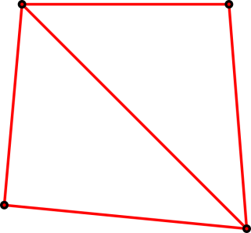
FE Body Stiffness Matrix
The flexible system stiffness matrix
Each sub-matrix k_{i,j}^{n} is the sub-matrix of stiffness coefficients associated with nodes i and j.
Element 1’s stiffness
No elements connect nodes 1 and 4.
q³
q⁴
System stiffness
Element 2
Element 1
Σ
q¹
q²
Element 2’s stiffness
System sub-matrix 2,3 is sum of element 1’s (2,3) and elements 2’s (2,3) sub-matrices.

Slide 77
FE Modal Reduction
To understand RFlex, first, modal reduction must be understood.
Modal analysis is performed on the system mass and stiffness matrices of a finite element body.
Relative to the body’s reference frame.
This requires that the elements are small deformation elements so that they have constant stiffness matrices.

Slide 78
FE Modal Reduction
The equations of motion of linear (small deformation) FE body is given by
(Ignoring damping)
Modal analysis is performed on the unforced system equations:

Slide 79
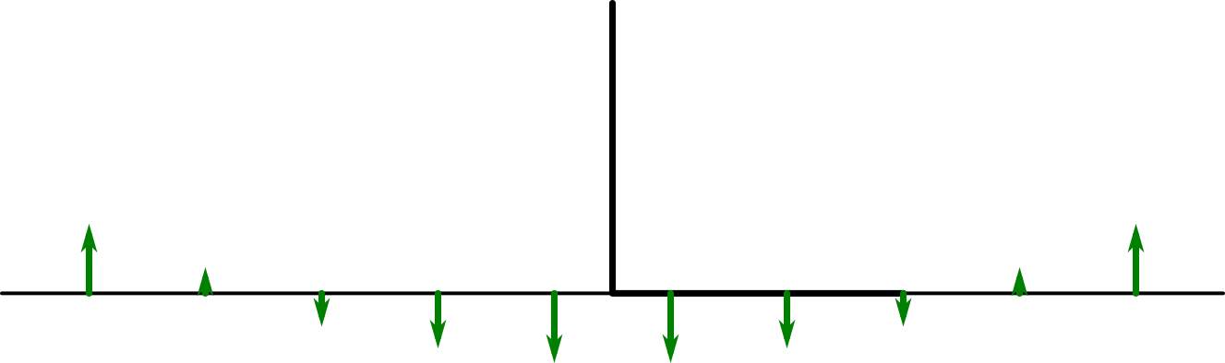
FE Modal Reduction Mode Shapes
Main assumption:
The body vibrates in harmonic motion in specified shapes.
In other words, vibration in any shape is specified by a mode shape vector ψ^{i} and a magnitude of vibration b^{i}.

Slide 80
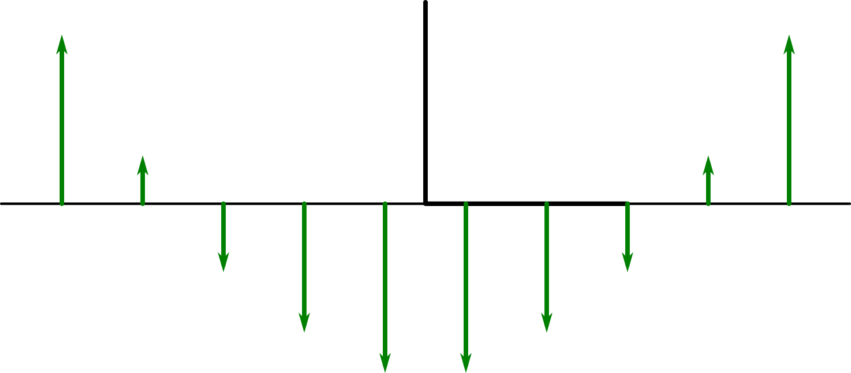
FE Modal Reduction Mode Shapes
Main assumption:
The body vibrates in harmonic motion in specified shapes.
In other words, vibration in any shape is specified by a mode shape vector ψ^{i} and a magnitude of vibration b^{i}.
b^{i} = 1
b^{i} = 4

Slide 81
FE Modal Reduction Mode Shapes
The total deformation shape during vibration is the sum of all vibration modes simultaneously:

Slide 82
Vibration Mode Dynamics
For any mode of vibration defined by mode shape vector ψ^{i} and a magnitude of vibration b^{i}, the equations of motion for that mode are

Slide 83
FE Vibration Similarity to 1 DOF Oscillator
The body equations of motion are now similar to a 1 DOF oscillator
It must be that every row of the system of equations is scalar of the same equation:

Slide 84
Vibration: The Eigenvalue Problem
Substituting the known solution into the modal equations of motion produces
which simplifies to

Slide 85
Vibration: The Eigenvalue Problem
This equation must be true always
including when t ≠ 0.
This can only be true if the coefficient is 0.

Slide 86
Vibration: The Eigenvalue Problem
This is the classical eigenvalue problem.
The eigenvalue problem
where

Slide 87
Vibration: The Eigenvalue Problem
This is an eigenvalue problem for matrix A.
ψ^{i} is any eigenvector of A.
λ^{i} is its associated eigenvalue.
A represents wave dynamics of the mass and stiffness of the system.
ψ^{i} is will be a shape in which the body naturally vibrates at a given frequency of ω^{i} = (λ^{i})^{1/2}.

Slide 88
Equivalent 1 DOF Oscillating System
Substituting one of these eigenvectors back into the original equations of motion of the body produces
in which every row is the same equation, differing by the force term and a scalar value.

Slide 89
Equivalent 1 DOF Oscillating System
The equivalent 1 DOF model needs to account for every force acting on every node.
The equivalent 1 DOF force is a weighted sum of the force elements.
The weighting is the mode shape itself.
The 1 DOF system can be found by pre-multiplying by the transpose of ψ^{i}.
which reduces to

Slide 90
A System of Modes
However, if the FE body has n DOFs, then there are n eigenvalues and eigenvectors.
Ψ is a square matrix.

Slide 91
A-Orthogonality of Mode Shapes
The eigenvectors are orthogonal to each other.
Specifically, they are A-orthogonal to both M and K.
If i ≠ j, then

Slide 92
System Equations of Motion
Pre-multiplying the equation by Ψ^{T} produces an identical n DOF system
Because of A-orthongality, M^{ψ} and K^{ψ} are diagonal.
The dynamics of the FE body has not changed.
But each DOF is independent of all others.

Slide 93
Reducing the DOFs
Usually, we don’t use all of the mode shapes.
We choose only a subset of them.
A small subset.
The lowest frequency modes only.
We choose how many we want to use (say, m mode shapes).
where m « n.
Ψ_{m} is generally not square. Usually, it has very few columns
(compared to Ψ)

Slide 94
The Reduced System with m DOFs
Using the reduced Ψ_{m} and Λ_{m} produces
which becomes
In this system, M_{c} and K_{c} are m x m diagonal matrices, and there are only m DOFs in b_{c}.
All DOFs are all totally independent of each other.

Slide 95
Modal Reduced System
The reduced FE system usually has very few degrees of freedom.
The accuracy of the dynamics of these equations depend on the load conditions.
It is accurate if the true deformation is similar to the chosen vibration mode shapes.
If the true deformation should be different than a sum of the chosen mode shapes, then the accuracy is low.

Slide 96
RFlex: Modal Reduction and a Reference Frame
RFlex requires a body reference frame that moves and rotates.
The global position of any point on a body is given by:
(This is the same equation used in the MBD formulation)
The point in the body reference frame
The reference frame rotation matrix
The origin of the reference frame in the global system

Slide 97
RFlex: Modal Reduction and a Reference Frame
An RFlex body deforms.
So sʹ moves relative to the reference frame.
The local point is not constant.

Slide 98
RFlex from a Modal Reduced FE Body
Modifying the global position equation for a flexible body that uses modal reduction:
Undeformed nodal coordinates relative to the body reference frame
The local point moves relative to the reference frame
The global position of a local point
Displacement relative to the body reference frame specified with modal reduction
The global position of a local, modal reduced point

Slide 99
RFlex from a Modal Reduced FE Body
Position on an RFlex Body
b_{c}
θ
x
Ψ_{c}

Slide 100
RFlex Derivation
The equations of motion for an RFlex body must be derived from a proper source.
The key difference between finite element formulations is the expression for r.
density * acceleration
Virtual displacement
Gravity force density
Gradient (change w.r.t. position) of stress = pressure force/vol

Slide 101
RFlex Equations of Motion
After all terms are computed, the RFlex equations of motion for a single body look like:
and Q^{d} is a vector of mass and velocity components commonly referred to as the “quadratic velocity terms”
For example
Coriolis terms
Gyroscopic force terms

Slide 102
MFBD = MBD + FFlex + RFlex
RecurDyn’s DAEs combine all 3 body types into 1 system of equations.
The system equations of motion:
All matrices and vectors include parts for
Rigid bodies
Full Flex bodies
Reduced Flex bodies

Slide 103
System Equations of Motion
The system equations of motion:
Each matrix and vector contains sub-matrices and sub-vectors of parts for rigid, RFlex, and FFlex bodies.
Superscript meaning:
^{r} : rigid
^{d} : reduced flex (RFlex)
^{f} : full flex (FFlex)

Slide 104
System Equations of Motion
Constraints:
Constraints can be defined between any body types.
For example, a constraint φ_{i} can constrain a rigid body to an FFlex node.
Any combination of body types is possible in a constraint.
RFlex matrices and FFlex forces are contained in the elastic force vector f^{e}.
There is no system FFlex stiffness matrix.
Each FFlex element is evaluated independently.
Contains connection forces and constraints for any body to any other body

Slide 105
Solving the System Equations of Motion
RecurDyn solves the entire system of DAEs together with a single numerical DAE solver.
A single time step is used for all equations of motion.
The DAEs are solved as a “monolithic system”.
It is not “co-simulation”, which uses different solvers for different parts.
(The equations shown here are the Newmark method)

Slide 106
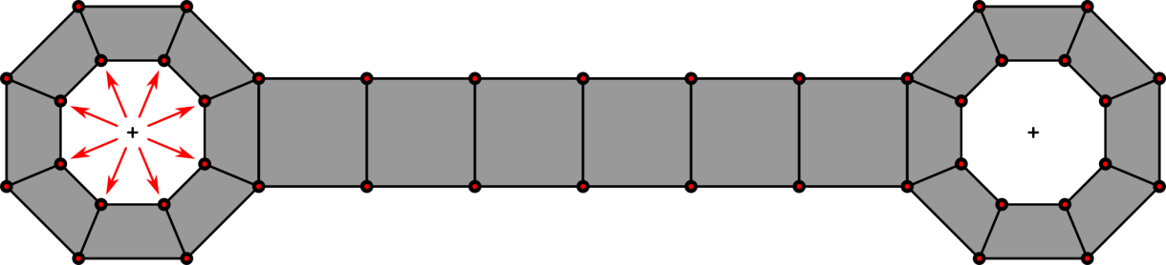
FFlex RBE (FDR) and RBE3
Connections to FFlex bodies
Should not attach constraints or elastic elements to a single node of an FFlex body.
This creates very unrealistic deformation in the body.
Should distribute connection forces over a large region of the mesh.
The force of a connection here should be distributed over many nodes

Slide 107
FFlex RBE (FDR) and RBE3
Connections to FFlex bodies
This is done with “Rigid Body Elements” (RBE).
There are 2 kinds of RBE elements in RecurDyn.
RBE “Rigid Body Element” elements
(also called FDR “Force Distributing Rigid”) elements
RBE3 elements
(also called Interpolation) elements.

Slide 108
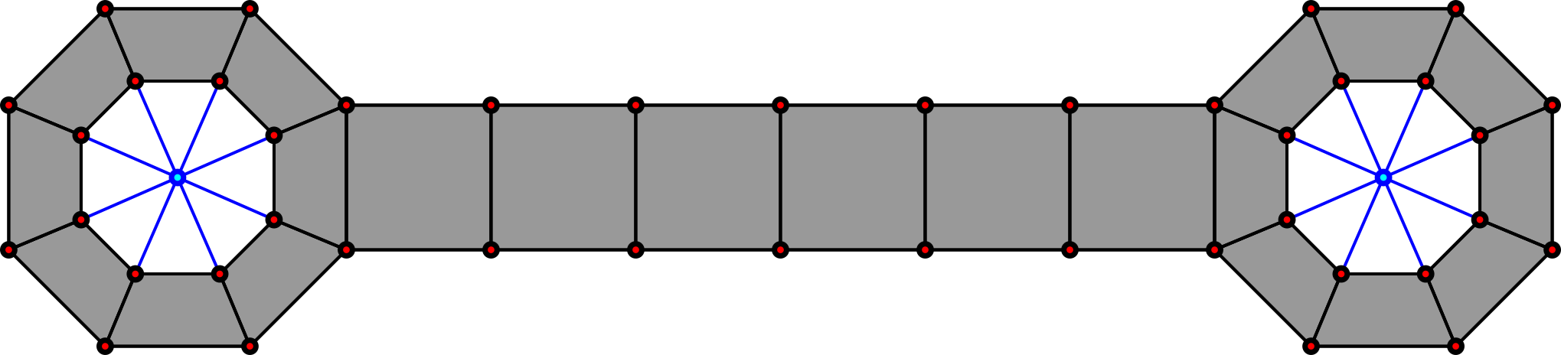
RBE Elements
RBE elements are like RBE2 elements in NASTRAN
Truly a rigid element.
Constrains a group nodes together.
Their relative positions are completely constrained.
Constrains position and rotation of nodes.

Slide 109
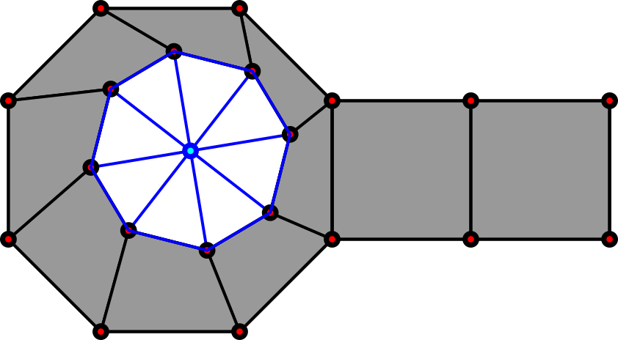
RBE Elements
RBE elements are like RBE2 elements in NASTRAN
The constrained nodes act like a rigid body.
The part of the mesh that is constrained by an RBE element cannot deform.
This part of the mesh becomes rigid.
Note: A constraint version and a stiff elastic version are implemented in RecurDyn.
The nodes constrained with an RBE element move like a rigid body

Slide 110
RBE3 Element
RBE3 elements are like RBE3 elements in NASTRAN.
A non-rigid, force-distributing element.
A constraint.
There is no elastic option for this element.
2 parts in the RBE3 constraint.
Position (translation)
Rotation
The RBE3 element allows the slave nodes to move.
The RBE3 element will not make a part of the mesh rigid.

Slide 111
RBE3 Element
RBE3 elements are like RBE3 elements in NASTRAN.
Be aware:
The RBE3 element cannot be used in all cases.
The slave nodes cannot be co-linear.
It is best if the master node is not close to any slave nodes.
RBE ≠ RBE3.

Slide 112
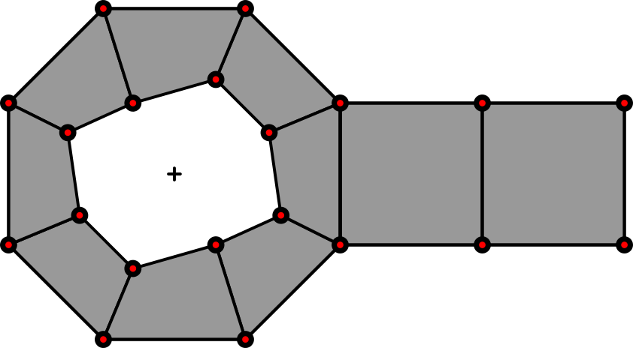
RBE3 Element
Position constraint
There is a master node and a set of slave nodes.
The master node is constrained to be in the average location of the slave nodes.

Slide 113
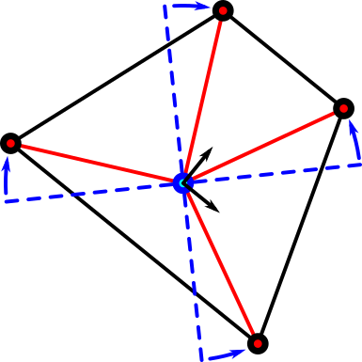
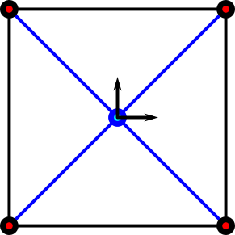
RBE3 Element
Rotation constraint
The orientation of the master node is constrained to the position of the slave nodes.
The orientation of the master node is the orientation that minimizes the angular differences between the current directions to the slave nodes.
Minimizes the squares of the angles.
θ_{φ}⁴
RBE3 Original Config.
θ_{φ}¹
RBE3 Original Config.
θ_{φ}³
Blue lines are the directions to the nodes in the initial configuration
Current orientation of master node minimizes the angular differences to the slave nodes.
θ_{φ}²

Slide 114
Contact
In MBD, “Contact” is an algorithm that calculates forces caused by bodies touching each other.
It prevents interpenetration of bodies.
It creates friction forces and slipping forces.
RecurDyn uses a penalty-based contact formulation.
Penetration between the bodies is permitted.
The normal force of contact is proportional to the amount of penetration.
Contact between any 2 bodies is permitted.
Rigid
FFlex
RFlex
The algorithm is mostly the same for all 3 body types.
There are various contact algorithms implemented in RecruDyn.
Only GeoContact is discussed in this document.

Slide 115
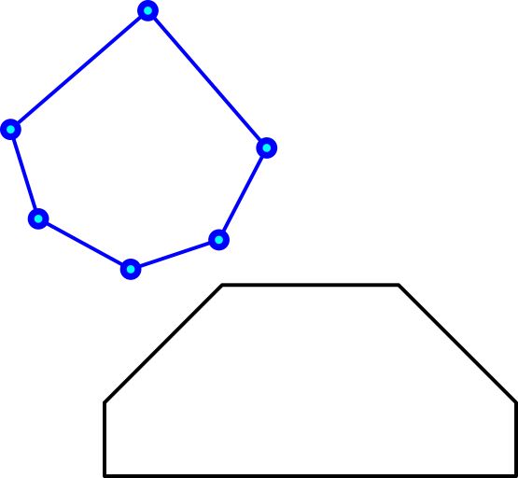
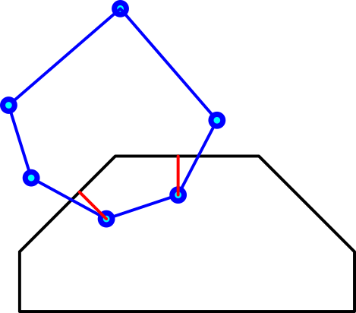
Contact Detection
Contact is detected by processing mesh geometry.
Bodies are meshed.
Polygons, Vertices
Detection:
Find vertices of one body passing through the mesh polygons of the other.
Any vertex that is inside of the other mesh is considered to be in contact.
Contact location
For any vertex inside the other mesh, a point on the mesh is found as the matching point of contact on the mesh.
The line from the vertex to the surface must be perpendicular to the surface of the mesh.
Every vertex can make contact independently.
If more than 1 vertex has passed through the other mesh, then each vertex is treated as a point of contact.
2 bodies
Contact detected between the bodies
Red lines are penetration lines to closest points on polygons.

Slide 116
Contact Normal Force
The contact normal force is implemented as a spring.
The contact normal force is proportional to the penetration.
(this above formula does not include damping)
User-definable exponent (default is 1)
Penetration
User-definable contact stiffness

Slide 117
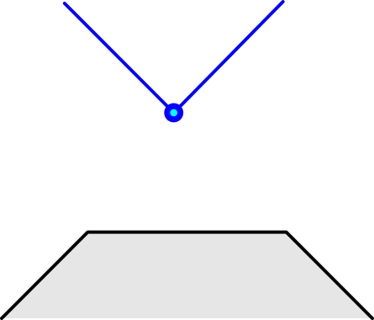
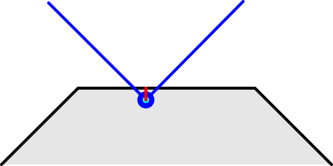
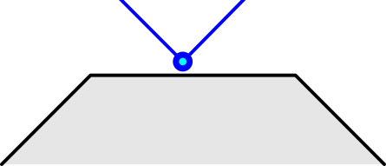
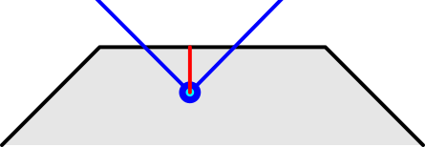
Step Size and Contact
Accuracy depends on solver time step size.
For a contact to produce accurate results:
Start of contact:
It must be detected soon after penetration begins.
End of contact
It must only exit a small amount in the time step that contact ends.
time = t_{i}
time = t_{i+1}
time = t_{i}
time = t_{i+1}

Slide 118
Step Size and Contact
At the start of the time step:
If there is no penetration, no contact force is used.
time = t_{i}
time = t_{i}
No contact at start of time step.
Contact not used during this time
Contact exists at start of time step.
Contact is used during this time

Slide 119
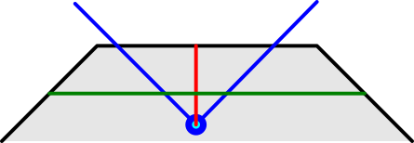
Step Size and Contact
At the start of the time step:
At the start of new contact
If the vertex penetrates deeply before the beginning of the first detection, a huge normal force is calculated.
This force adds energy to the system.
It can add a huge amount of energy.
time = t_{i-1}
time = t_{i}
Expected maximum penetration
The node penetrates too deeply. The penetration is deeper than the expected maximum penetration for this contact. The normal contact reaction force will be too large.

Slide 120
Step Size and Contact
At the start of the time step:
At the end of an existing contact
If the vertex escapes the surface a large distance during its last step of contact, the spring will remove energy from the bodies.
It will apply an unrealistic cohesive force, pulling the bodies back together.
time = t_{i+1}
Between t_{i} and t_{i+1}, the contact force will unrealistically pull the node down (like a cohesion force)
time = t_{i}
The node starts the time step in contact, so contact is used during this step. The node travels far out of the mesh during the step. An unrealistic amount of energy will be lost because the contact was applied too long.

Slide 121
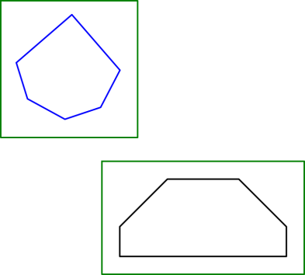
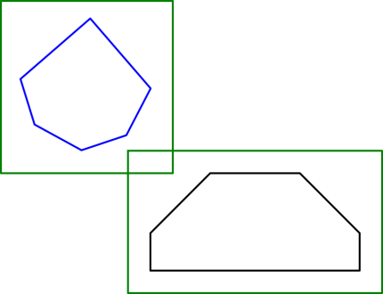
Step Size and Contact
Solution: Use small time steps when contact is about to begin or end.
This will minimize:
The penetration before the first time step that contact is detected.
The separation of the vertex from the mesh on the last time step of contact.
Bounding boxes:
RecurDyn has an option to detect when contact surfaces are close. When they are close, the solver can reduce the maximum time step by a fixed factor.
When the bounding boxes intersect, the maximum time step is reduced by fixed factor to improve contact response.
Bounding boxes around the contact surfaces

Slide 122
Thank You

